Slide 1
Offset Register (Add New)
3 Tabs
Detail
Authorization
Information Sources
GIS Capture Province(s) Municipalities SG Codes Extent
Detail
Offset Register ID (Unique Identifier) Generated by System Application Title Activity Description Development Type Other Attributes
Authorization
Add Offset(s)
Information Sources
Offset Attributes
GIS Capture (Offset Location)
Add Amendment(s)
Implementation Attributes
Add New
Confirmation of flow
GIS Capture Screens
Detail Tab (Project/Dev level?)
Authorization → Offset Tab (Offset level?)
Attributes confirmation for each screen
Detail
Authorization
Offset
Implementation
Amendment
Information Sources

Slide 2
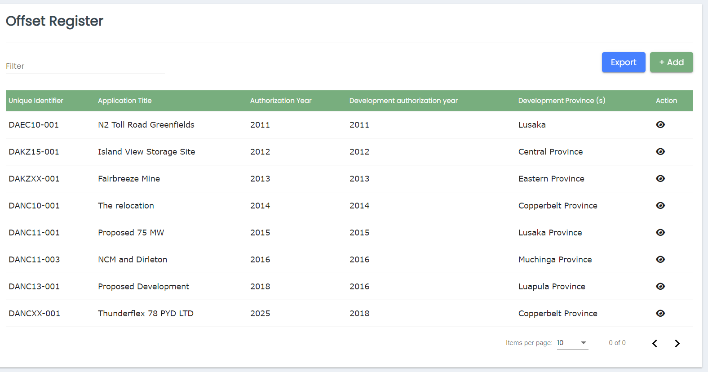
Unique Identifier – remove from the grid but keep in db
Sorting
Filter
Globe icon – map viewer zoomed to location
Remove development authorization year
Date Filter (Date Range) (Permit date of issue – multiple records)

Slide 3
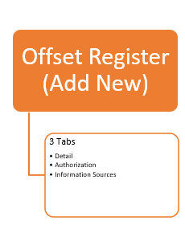
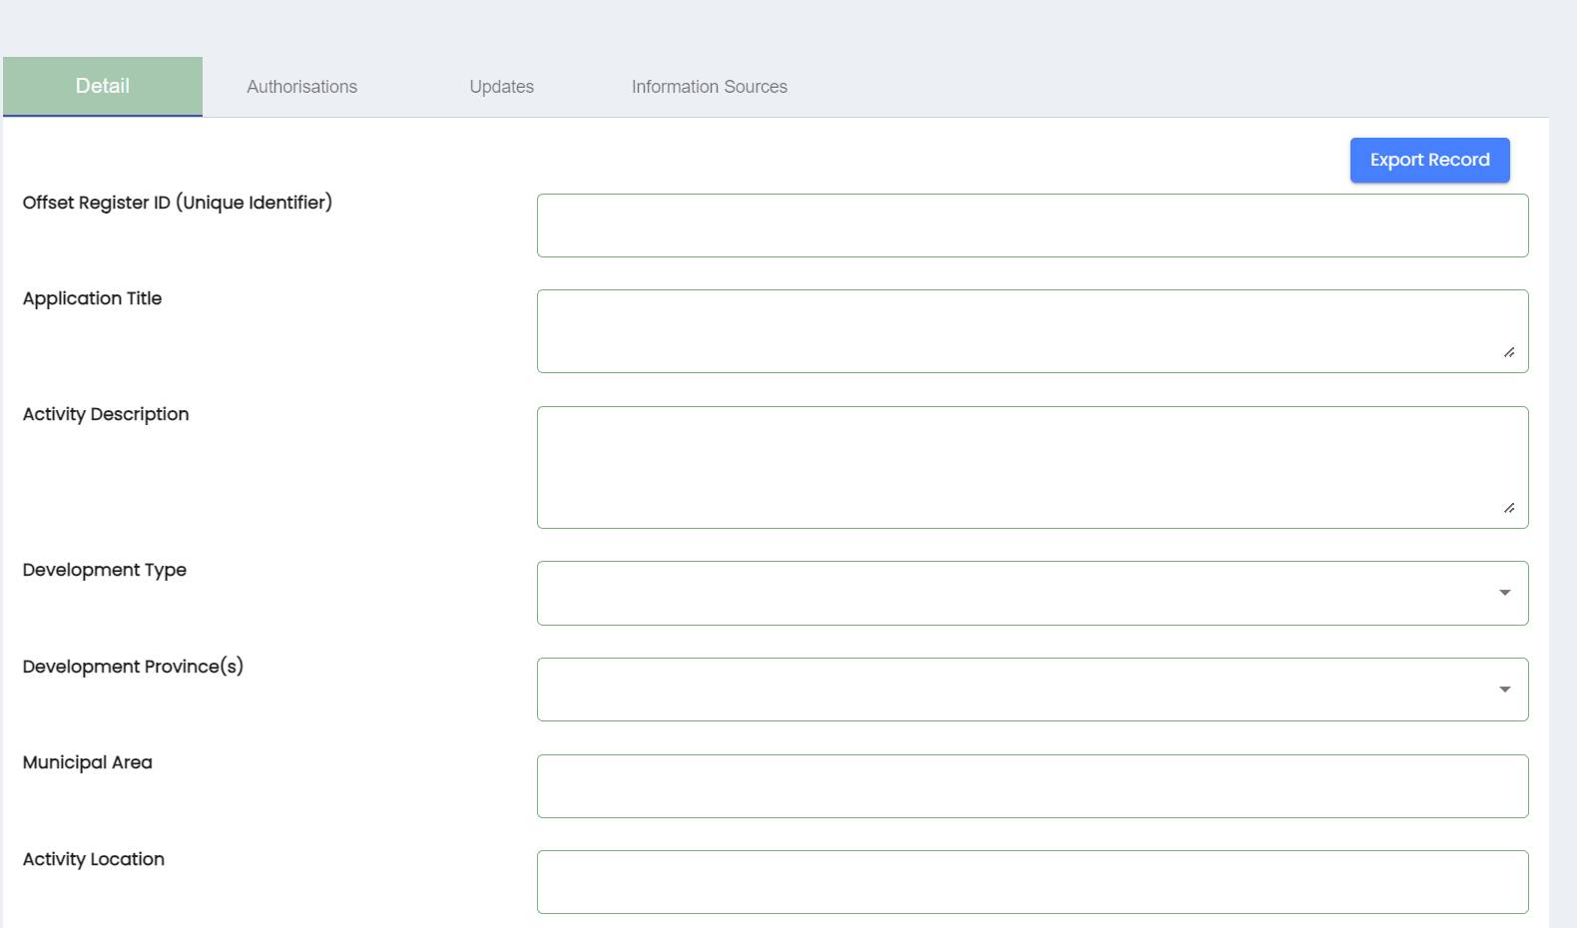
Remove Updates Tab
Add Record to Offset Register
Term – Project? Or Development?

Slide 4
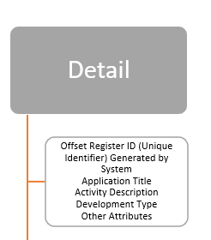
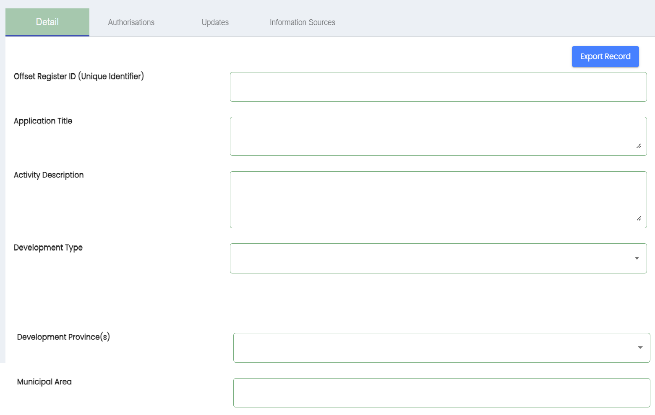
GIS capturing at Project/Development level?
Capture Location

Slide 5
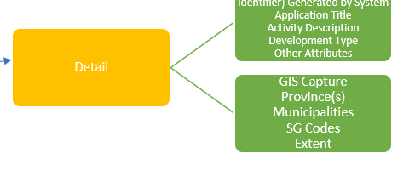
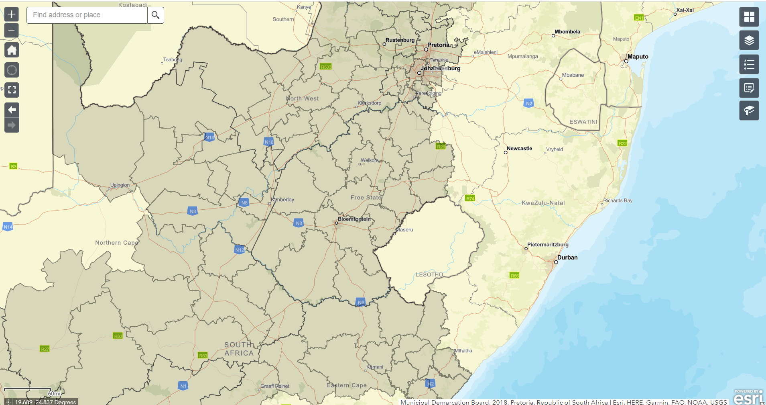
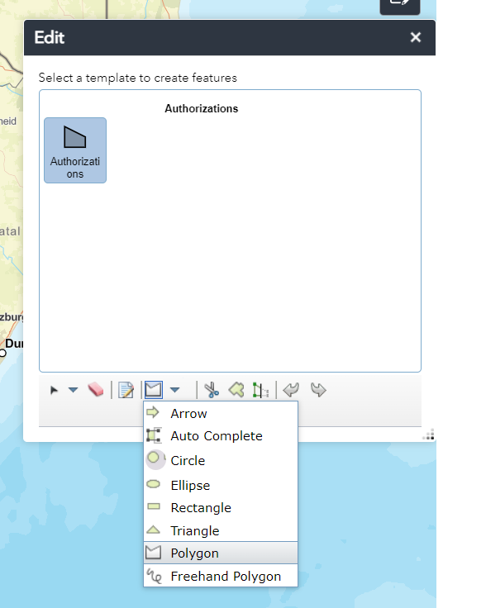
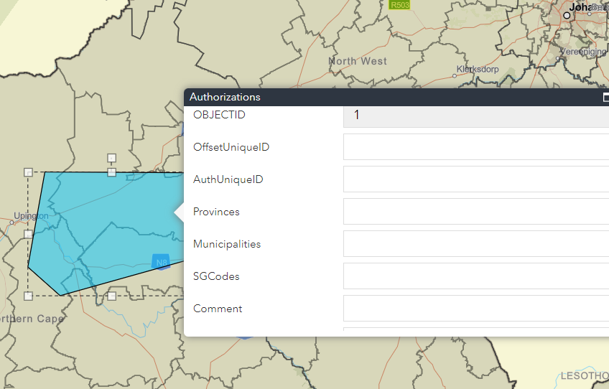
Capture Location
Widgets
Base Map
Layer Manager
Legend
Navigation toolbar
Zoom In/Out
Home
Current Location
Zoom Prev/Next

Slide 6
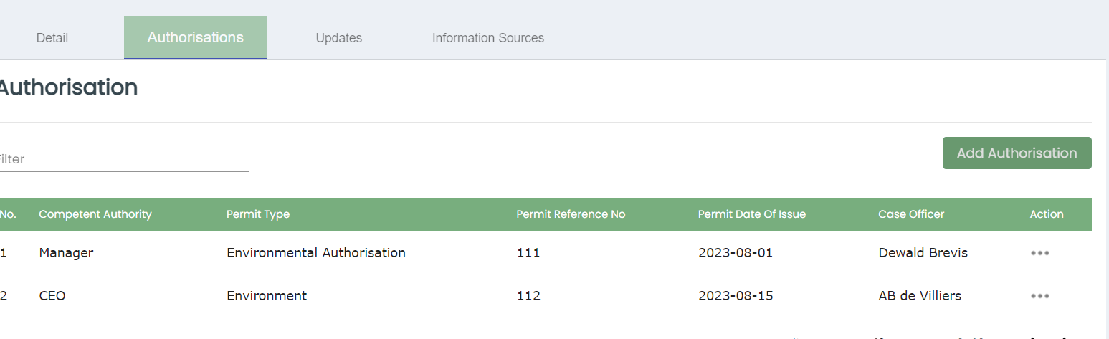
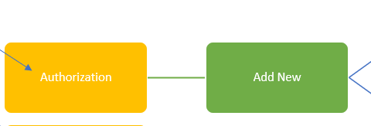
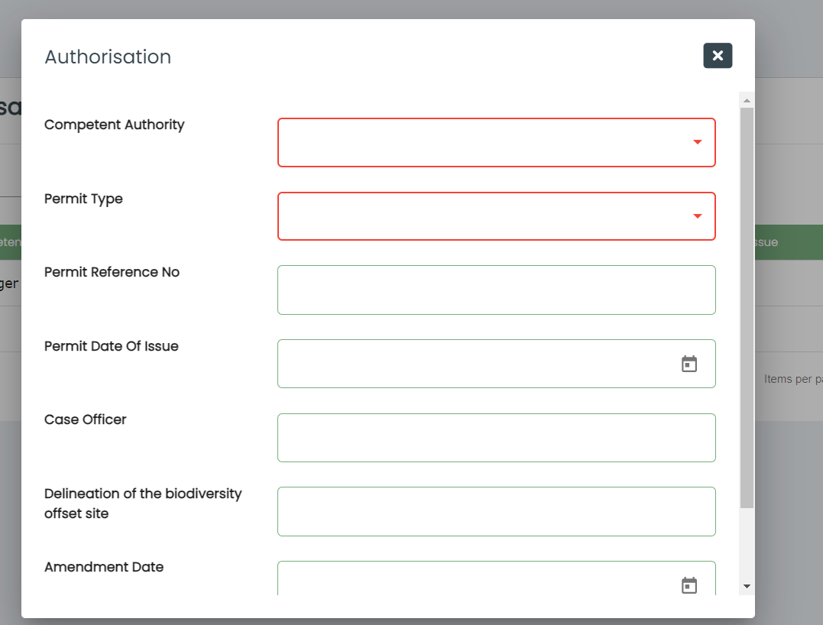

Slide 7
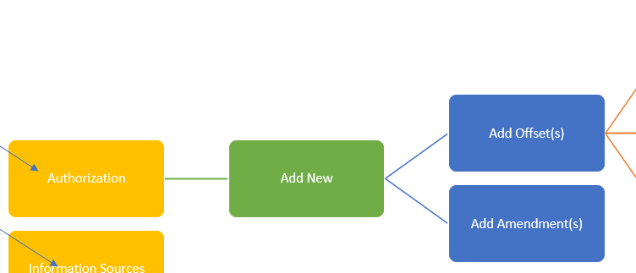
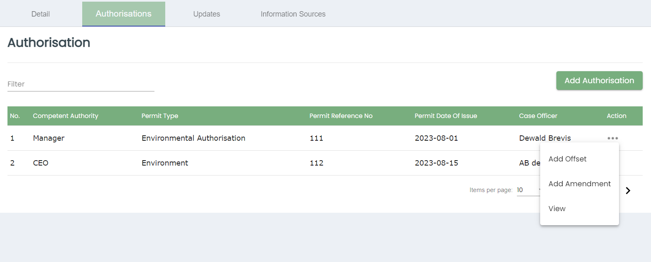

Slide 8
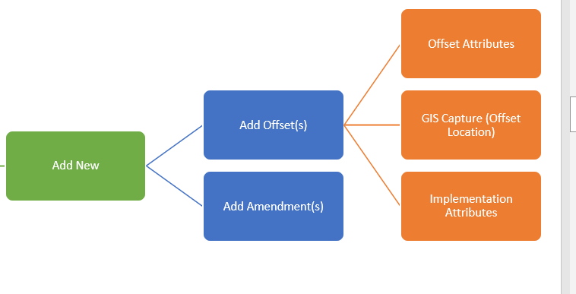
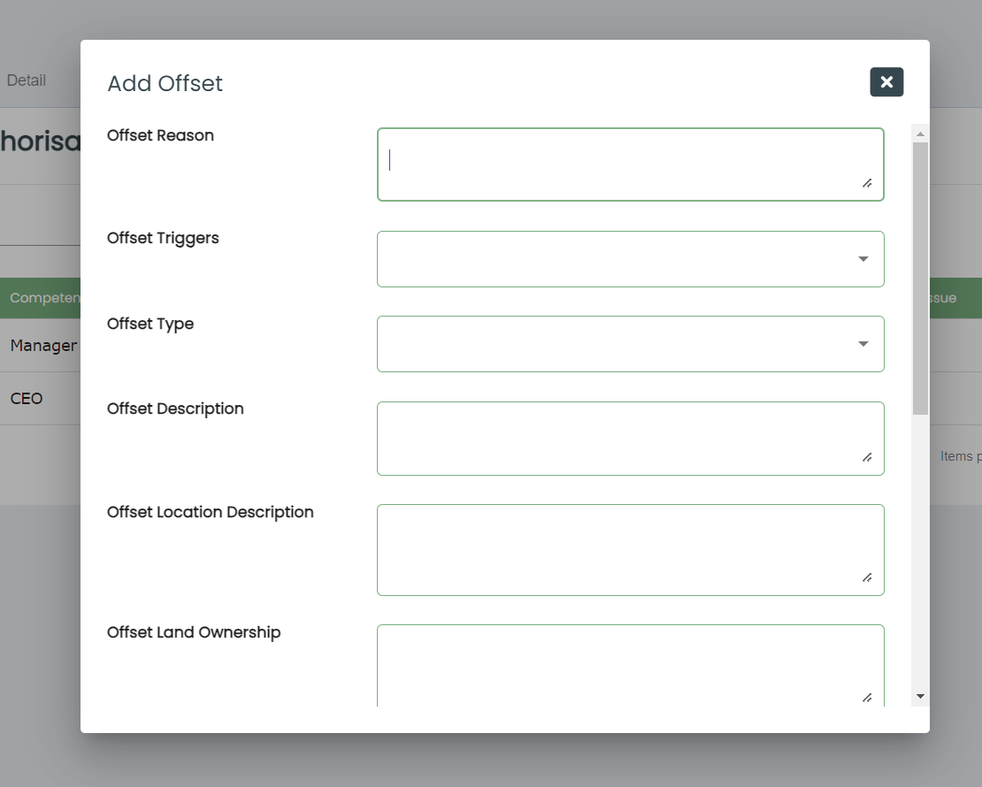
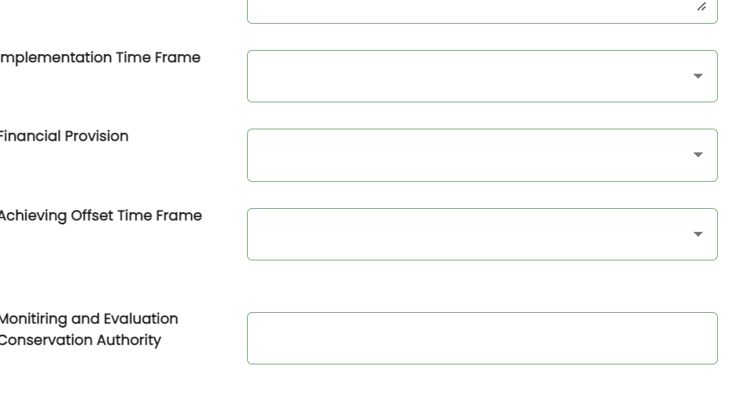
2nd GIS capture screen? At offset level?
Capture Location
Implementation attributes either to follow the same screen or a new modal window

Slide 9
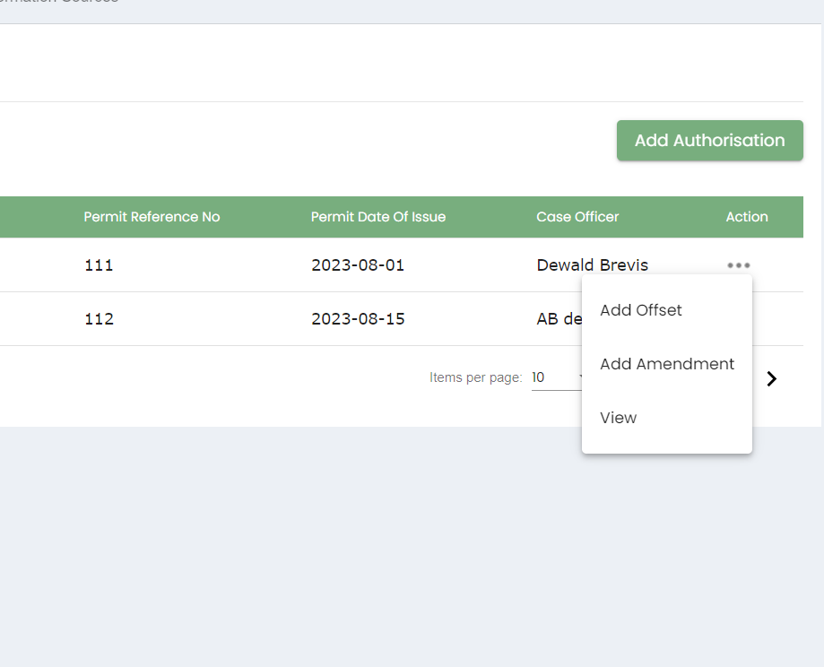
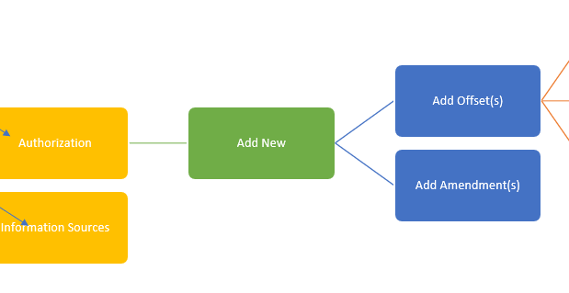
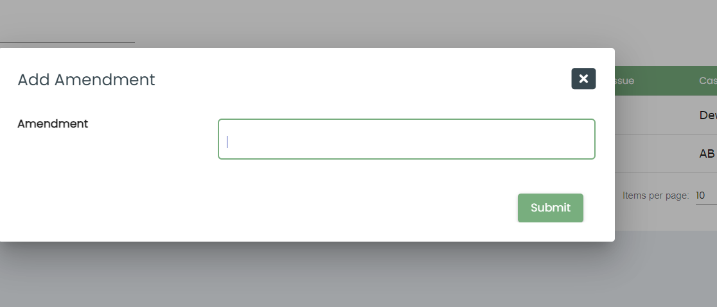
Amendment attributes as required

Slide 10
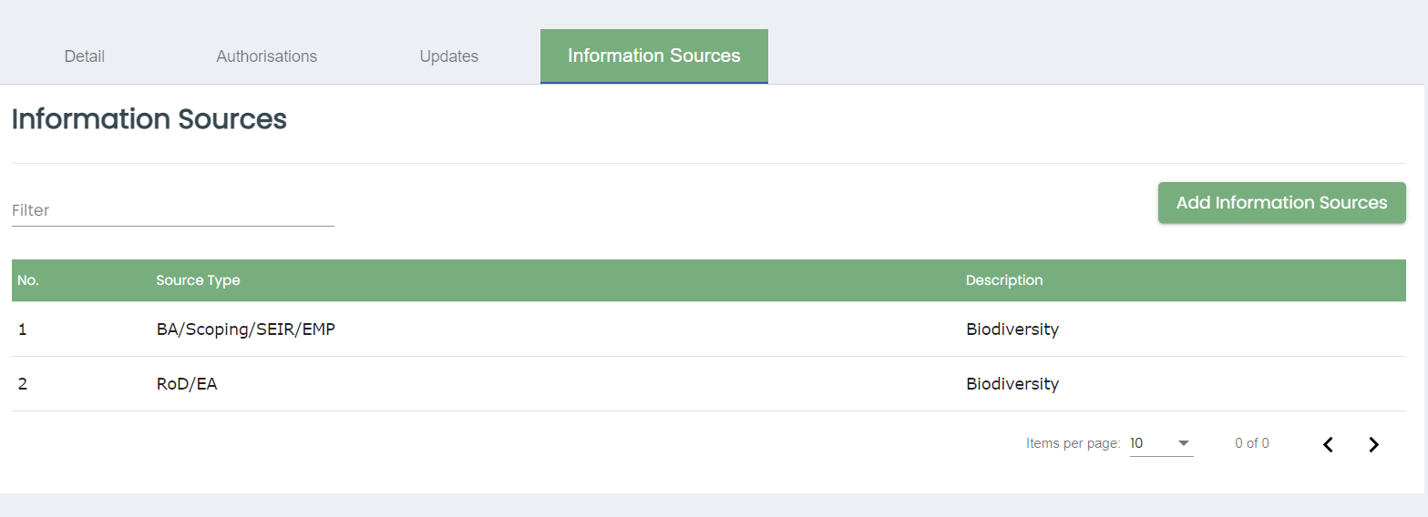
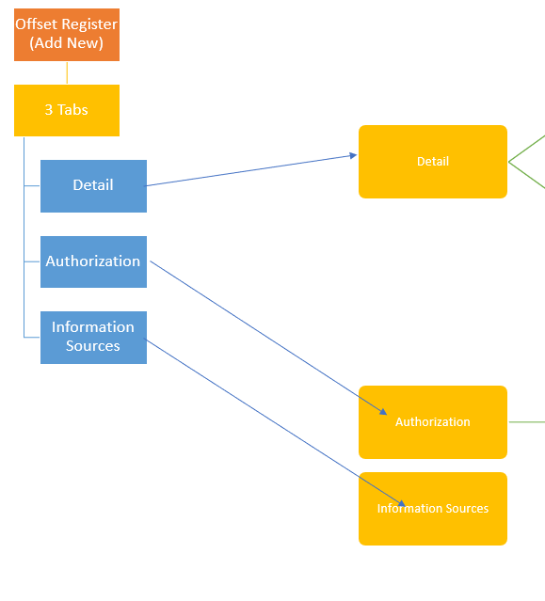
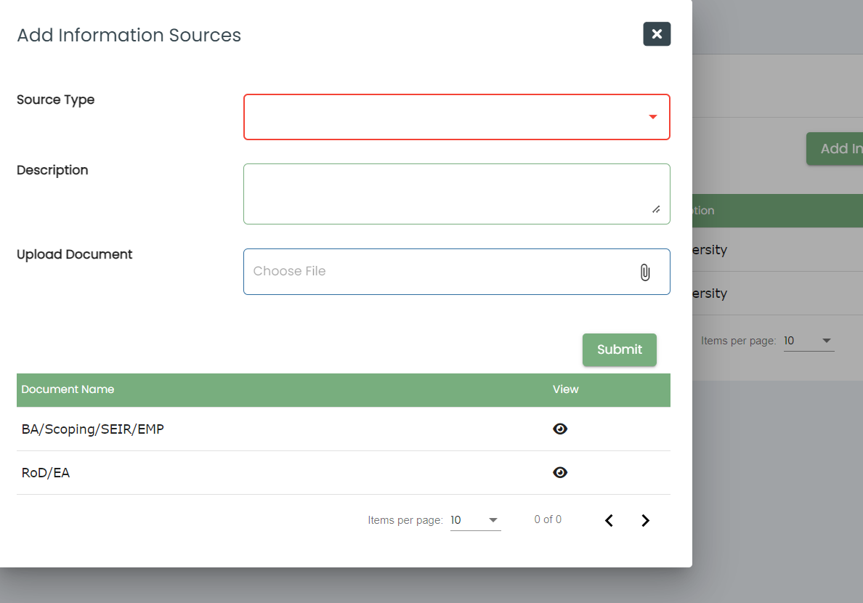
Information Sources attributes as required

Slide 11
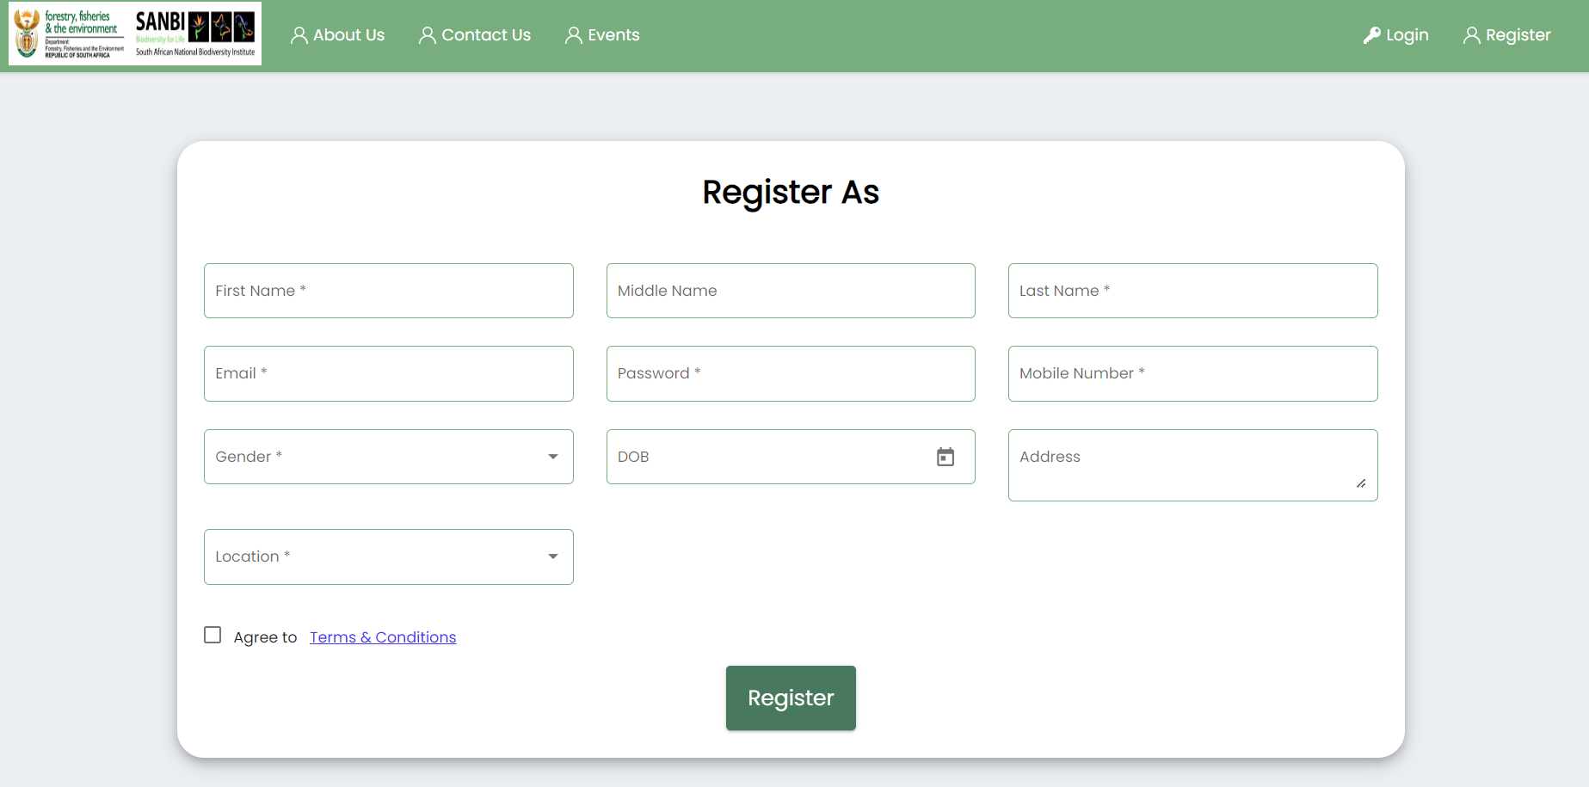
User Registration process:
Registration through this form.
By default, user can only view
Admin Page
User rights (activate/
deactivate)
Editable
View

Slide 12
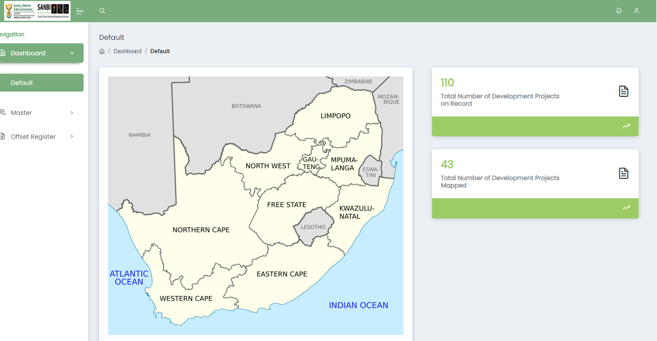
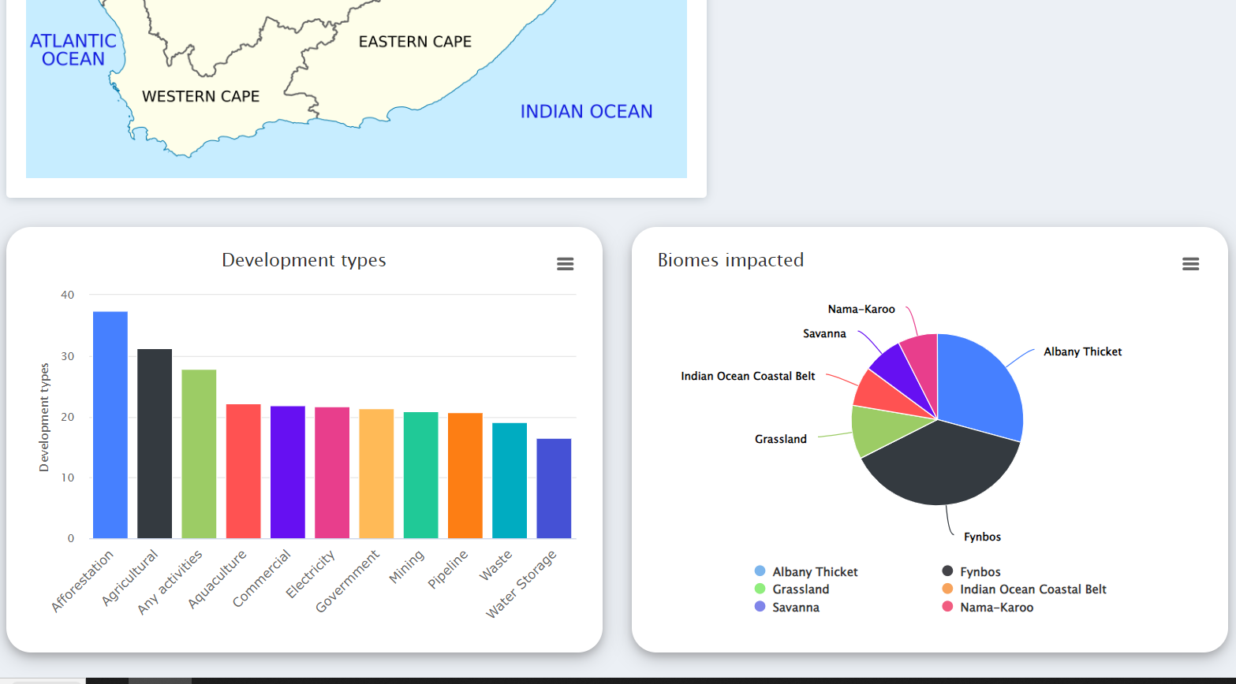

Slide 13
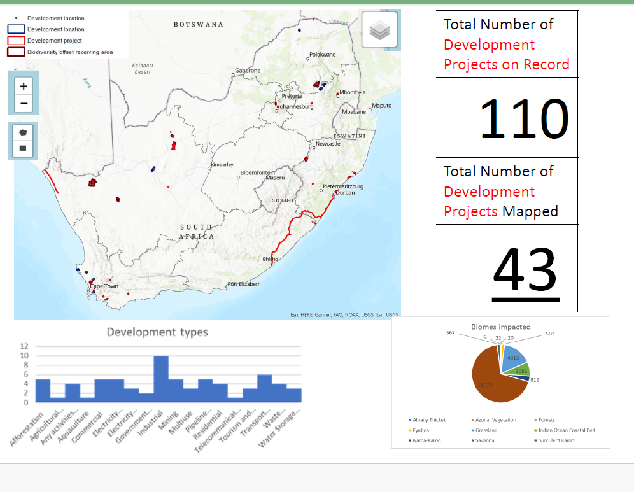
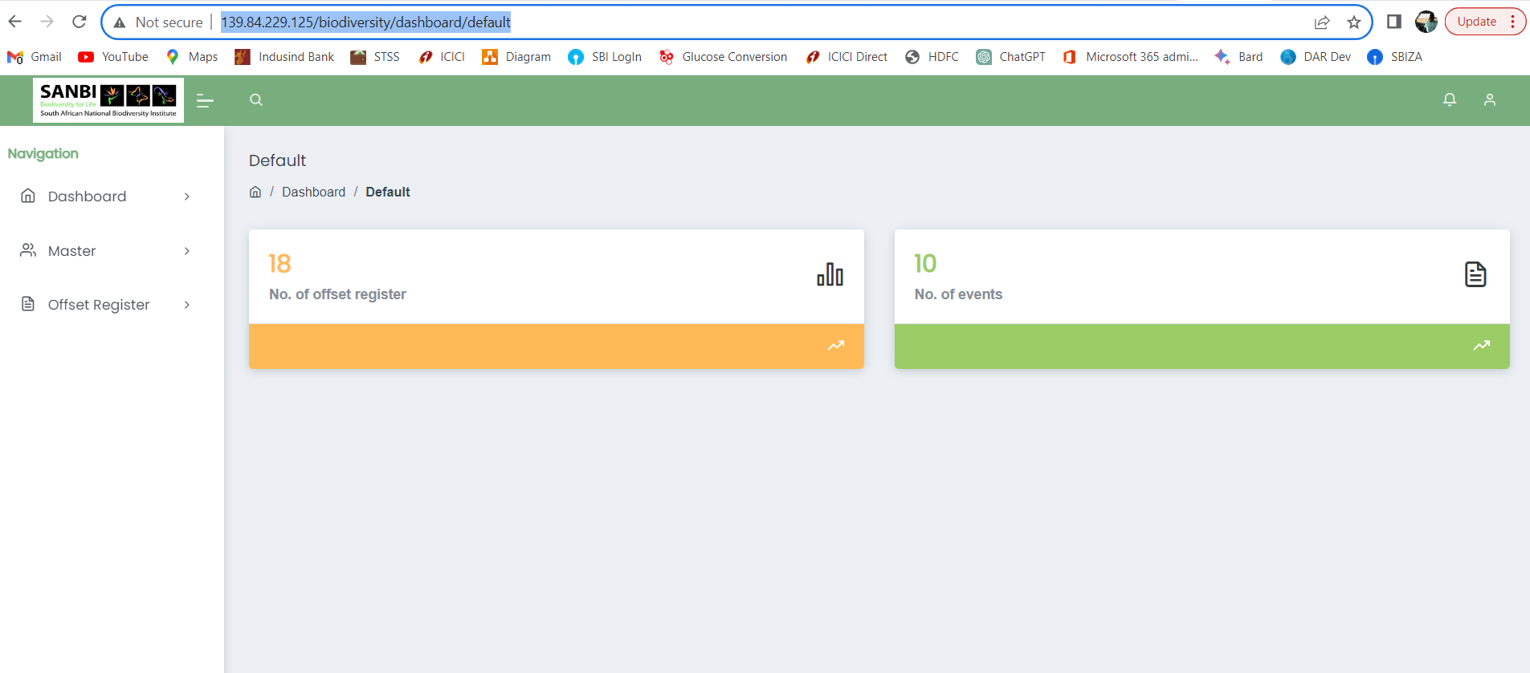
New UX
http://139.84.229.125/biodiversity/dashboard/default
Dashboard to contain:
Map viewer showing the project polygons and info
Charts/Graphs

Slide 14
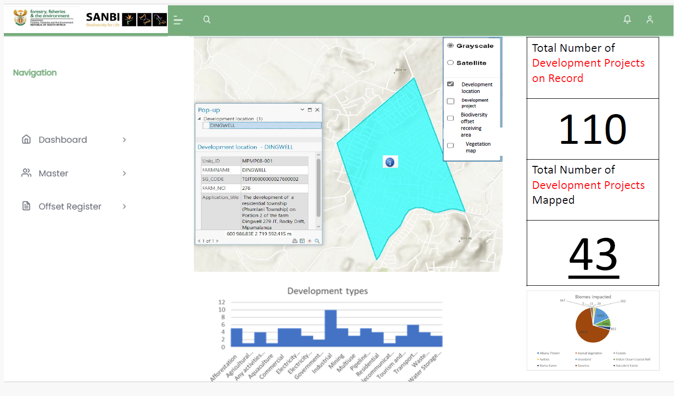
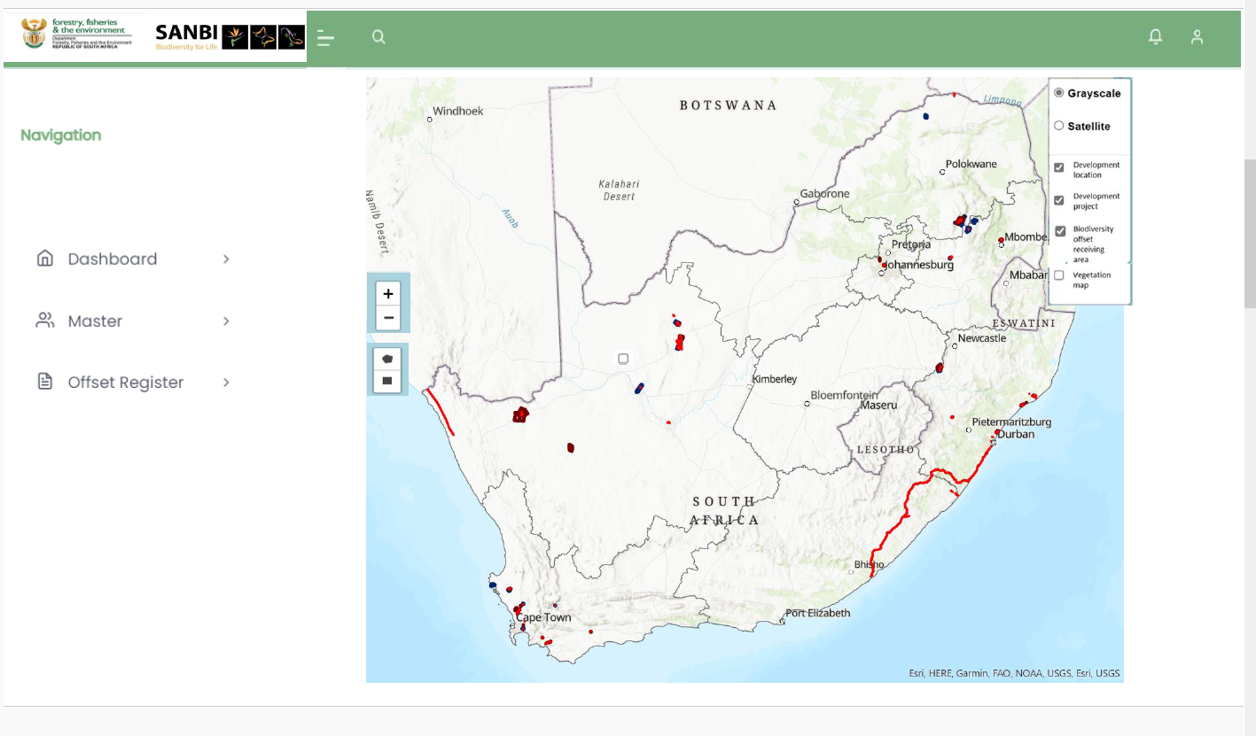
Project Info to be displayed when identifying a polygon
http://139.84.229.125/biodiversity/dashboard/default

Slide 15
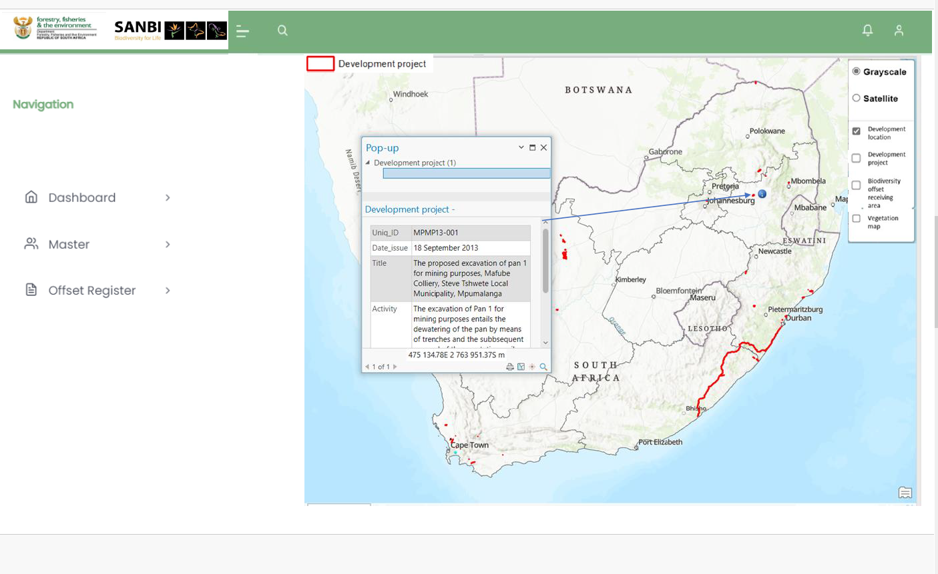
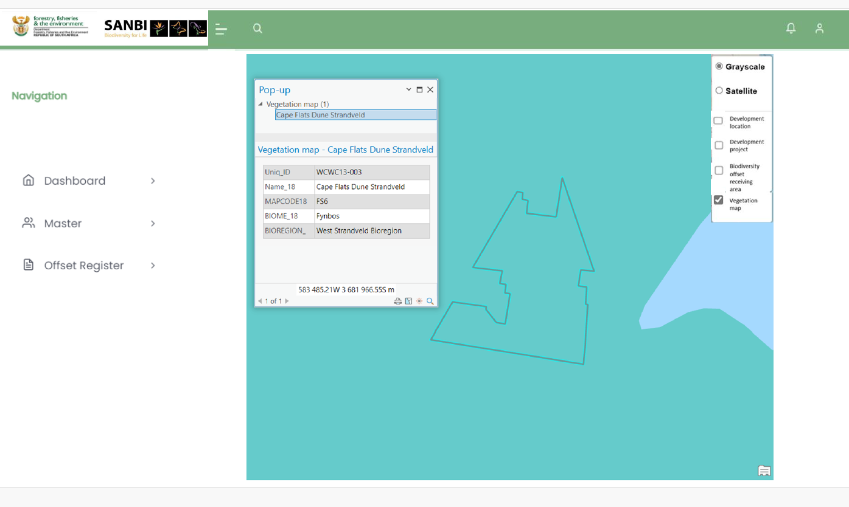
Project Info to be displayed when identifying a polygon
http://139.84.229.125/biodiversity/dashboard/default

Slide 16
GIS Viewer (Read Only)
Dashboard
GIS Viewer (Capturing)
Spatial View of records
Capture Polygons
Automatically fetch
Municipalities
Province(s)
SG Codes
Technology
Configure the map in ArcGIS Pro and publish on ArcGIS Online
Customized Javascript Viewer
Embedded into an iFrame/Modal Window
Extent

Slide 17
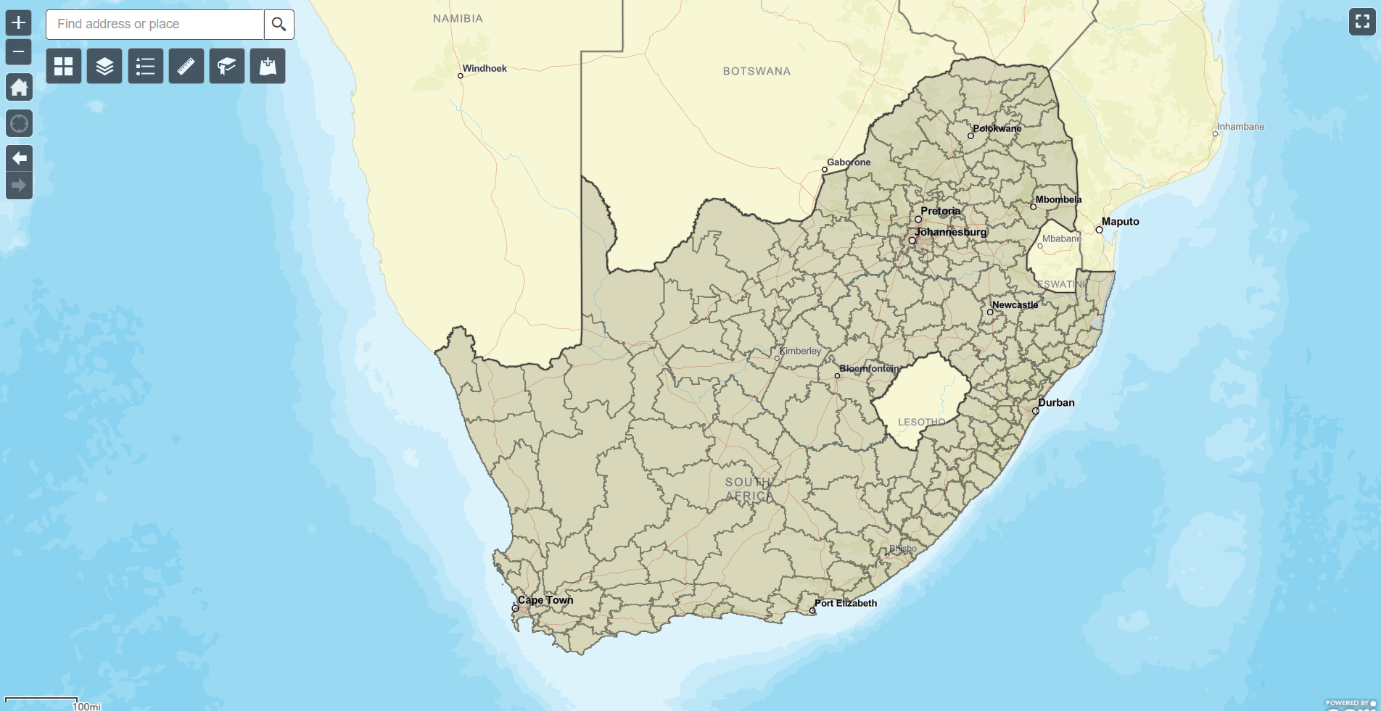
http://154.0.173.223/BioFin/ [READ ONLY GIS VIEWER]
Widgets
Search
Base Map
Layer Manager
Legend
Measure
Bookmarks
Add Data
Navigation toolbar
Zoom In/Out
Home
Current Location
Zoom Prev/Next

Slide 18
http://154.0.173.223/BioFinEdit/ [GIS Viewer for capturing]
Widgets
Base Map
Layer Manager
Legend
Navigation toolbar
Zoom In/Out
Home
Current Location
Zoom Prev/Next

Slide 19
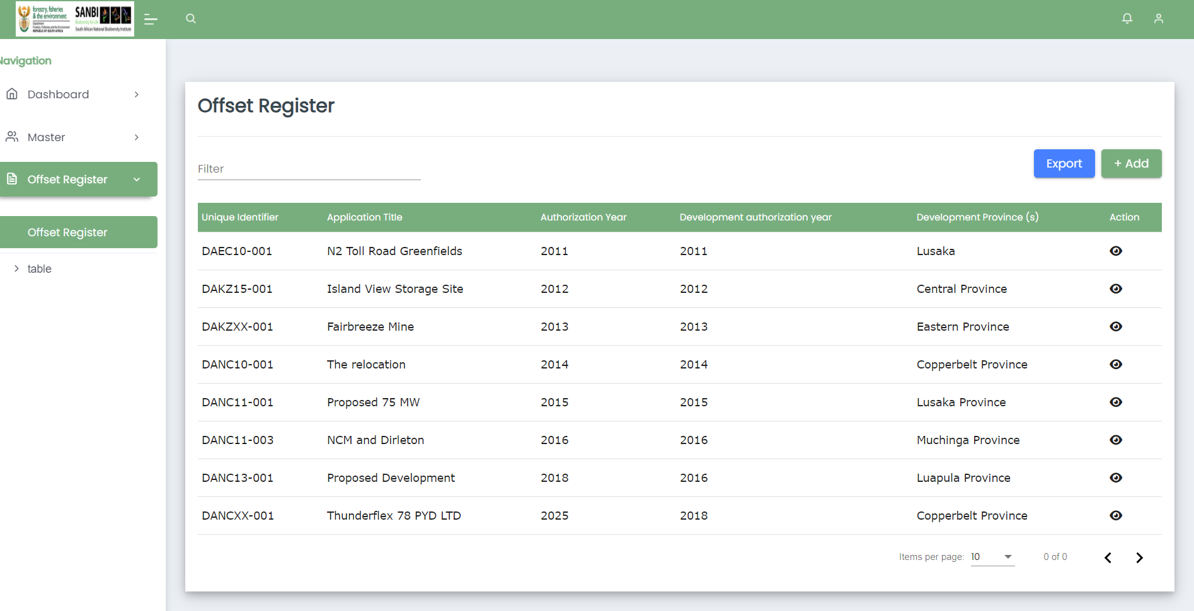
Unique Identifier – remove from the grid but keep in db
Sorting
Filter
Globe icon – map viewer zoomed to location
Remove development authorization year
Date Filter (Date Range) (Permit date of issue – multiple records)

